Slide 1
CSRF Cross Site Request Forgery
LukaS Hall, Matt Garza, Juan Bermudez

Slide 2
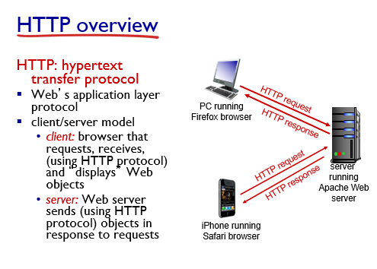
Review of the Internet
Client connects to server via 3 way handshake
The connection is established by TCP
The client requests embedded objects from the server (URLs, imgs, videos, etc)
The server sends them

Slide 3
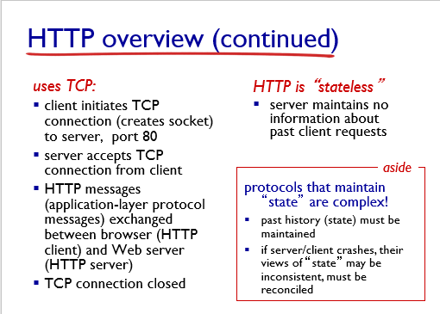
Cookies
HTTP is stateless, the connection closes once a response ends
In order to maintain state we use cookies
Cookies are stored in the server
The cookies help authenticate the user, and to re-establish a connection

Slide 4
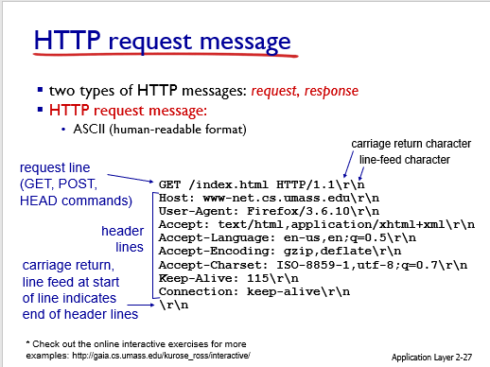
Request & Response
Get and Post commands are used frequently in HTTP
Get retrieves data, such as documents, images, links, and other resources
Post is used to write, insert, or update data. It is also used to fill forms.

Slide 5
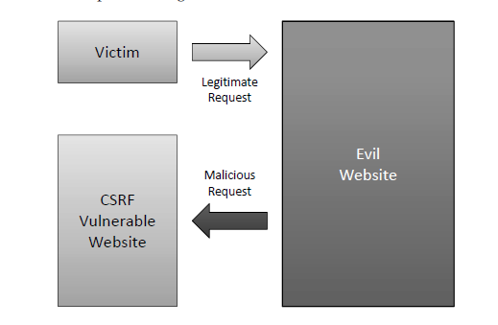
So what is CSRF?
A user has a session established with a trusted website ( by the cookies)
A malicious user lures the victim into clicking on a third party website
The malicious site injects an HTTP request into the victim’s session
The attack will execute unwanted commands for the victim (as if they did it themselves)

Slide 6
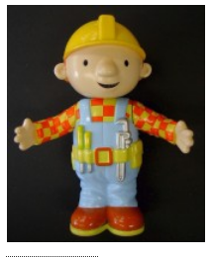

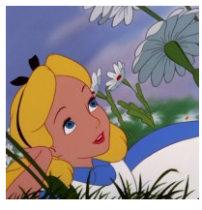



Task 1@ Elgg.com
Boby’s blog:
www.attacker.com
1. Alice logs in to elgg 2. Alice clicks on Bobby’s attacker Link 3. The link has a get request to add Bobby 4. Elgg approves the request
Elgg Server
Bobby added as friend

Slide 7
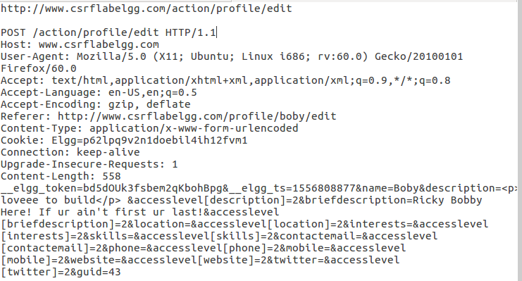
Task 3: Post Request Anatomy
Path to resource & Protocol Version
Request line & Http method
Request headers
Mssg body (Payload)

Slide 8

Task 3@ Elgg.com
Boby’s blog:
www.attacker.com
1. Alice logs in to Elgg 2. Alice clicks on Bobby’s attacker Link 3. The link has a Post request that write’s “Bobby is my hero” on Alice’s about me section 4. Elgg approves the request
Elgg Server

Slide 9
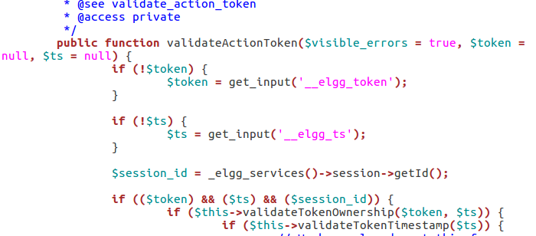
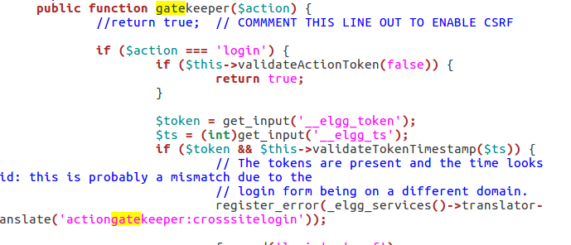
Countermeasure:
Create unique time stamps and tokens for every time Alice clicks on something
Compare the time stamps with Alice’s session ID. If actions generated do not match with Alice’s unique values, then validation fails, and session expires

